Slide 1

Feb, 2025
Manipal University Jaipur
Leveraging Aspect-Oriented Opinion Analysis to Evaluate Consumer Perceptions in Indian Healthcare Settings (JIO Collaborative Project)
Shaurya Saxena - IT A (229302033)
Brindeshwar Sharma - IT A (229302035)
Under the Guidance of
Dr. Bagesh Kumar
END– TERM PRESENTATION
2024-2025

Slide 2
INTRODUCTION
TABLE OF CONTENTS
PROBLEM STATEMENT & AIM
DATASET USED
LITERATURE REVIEW
PROPOSED METHODOLOGY
RESULT
CONCLUSION
FUTURE SCOPE
REFERENCES

Slide 3
INTRODUCTION
Online drug reviews offer insights into efficacy, side effects, and satisfaction.
Rising volume demands automated sentiment analysis for actionable insights.
Aspect-Based Sentiment Analysis (ABSA) targets specific aspects (e.g., effectiveness, side effects) for granular feedback.
Project uses deep learning (e.g., BERT) to predict star ratings (1–5) with >80% accuracy.
Helps patients make informed decisions and assists providers in improving treatments.
ABSA enables precise, scalable feedback analysis useful in telemedicine, drug development, and patient care.
1

Slide 4

PROBLEM STATEMENT
Challenge: Large number of reviews with mixed sentiments
1
Limitation: Existing methods struggle with aspect-specific insights
3
Need: Automated, high-accuracy sentiment prediction
4
Impact: Improves healthcare decision-making
5
Issue: Manual analysis is slow, inaccurate for large data
2
2

Slide 5

AIM
Goal: Predict star ratings (1-5) for drug aspects
Target: Achieve >80% accuracy on ~50,000 balanced samples
Implement ML models for sentiment classification
Features: Focuses on text, ratings, and aspects
Outcome: Enhance patient and provider insights
4

Slide 6
DATASET USED
Size: ~161,297 drug reviews
Source: [11]
Samples: ~81,555 initial(aspect
pairs), balanced to 50,000
(10,000/label)
Features:uniqueID,drugName,
condition,review,rating,date,
usefulCount
Purpose: Enables aspect-
specific sentiment analysis
3

Slide 7
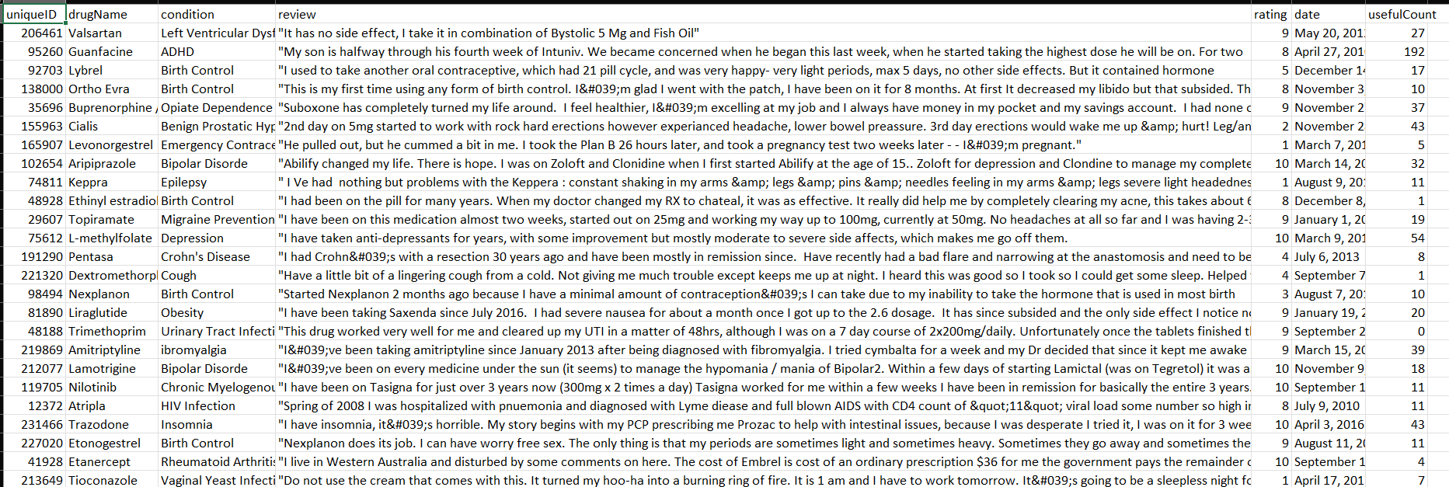
DATASET SAMPLE
SOURCE- [11]
6

Slide 8

DATA PREPROCESSING & CLEANING
Initial Data: Loaded ~161,297 drug reviews from CSV
Cleaning: Lowercased text, removed URLs, handled nulls
Preprocessing: Extracted ~81,555 aspect-opinion pairs
Balancing: Adjusted to 50,000 samples (10,000/label)
Impact: Enabled 94.33% BERT accuracy
7

Slide 9
LITERATURE REVIEW
1. Sentiment-Based Analysis (B. Schmitt)
• Approach: Classifies text as positive, negative, or neutral using lexicon-based sentiment analysis.
• Limitations: Ignores context-specific sentiment variations, fails to identify aspect-level sentiments (e.g., good doctor but bad staff).
• Accuracy Issues: Works well for general sentiment classification but lacks aspect-based granularity.
2. Latent Dirichlet Allocation (LDA) for Topic Modelling (L. Satish and N. Yusof)
• Approach: Extracts hidden topics from textual data using probabilistic topic modeling.
• Limitations: Identifies topics but does not classify sentiments, struggles with short text reviews (e.g., "Very bad experience.").
• Performance Issue: Topic coherence score is inconsistent (varies across datasets).
3. Machine Learning-Based Sentiment Analysis (Pang & Lee)
• Approach: Uses supervised machine learning models like Naïve Bayes, SVM, and Random Forest for sentiment classification.
• Limitations: Requires large labeled datasets for training, fails to handle sarcasm, negations, and implicit sentiments.
• Accuracy: 75-85% depending on the dataset, struggles with domain-specific terminologies (e.g., medical terms).
9

Slide 10
LITERATURE REVIEW(CONT..)
4. Deep Learning for Aspect-Based Sentiment Analysis (H.J. Lee)
• Approach: Uses deep learning models (BiLSTM, CNN, and Transformer-based models) to extract aspects and predict sentiment.
• Limitations: Computationally expensive and requires extensive labeled data, can misinterpret ambiguous or mixed reviews.
• Accuracy: Aspect Sentiment Detection Accuracy: ~80-90% in large datasets, struggles with low-resource languages and short-text reviews.
5. Aspect-Based Opinion Mining in Healthcare (Rana et al.)
• Approach: Uses NLP and sentiment analysis to evaluate healthcare-related patient reviews.
• Limitations: Relies on predefined aspect categories, limiting flexibility, faces challenges in multilingual reviews (e.g., Hindi-English mix).
• Performance: Aspect Identification Accuracy: ~85%, Sentiment Classification Accuracy: ~80%.
10

Slide 11
COMPARISON TABLE OF DIFFERENT MODELS
Model | Approach | Accuracy Score (%) | Limitations
Logistic Regression | Binary sentiment classification | 80-90% | Struggles with complex text structures
Naïve Bayes | Probabilistic text classification | 60-70% | Assumes feature independence, which is unrealistic
Support Vector Machine (SVM) | Text sentiment classification using hyperplanes | 75-85% | High training time, sensitive to noise
Latent Dirichlet Allocation (LDA) | Unsupervised topic modelling | 65-70% | Does not classify sentiment, only topics
Random Forest | Ensemble-based text classification | 70-78% | Overfits on high-dimensional data
Convolutional Neural Network (CNN) | Deep learning for sentiment classification | 85-90% | Requires large training data, struggles with long text dependencies
Bidirectional LSTM (BiLSTM) | Recurrent neural network for text processing | 86-90% | Computationally expensive, slow inference time
Distil BERT (Transformer-based NLP) | Pretrained transformer for aspect sentiment | 90-94% | Needs huge datasets, fine-tuning complexity, high inference cost
11

Slide 12
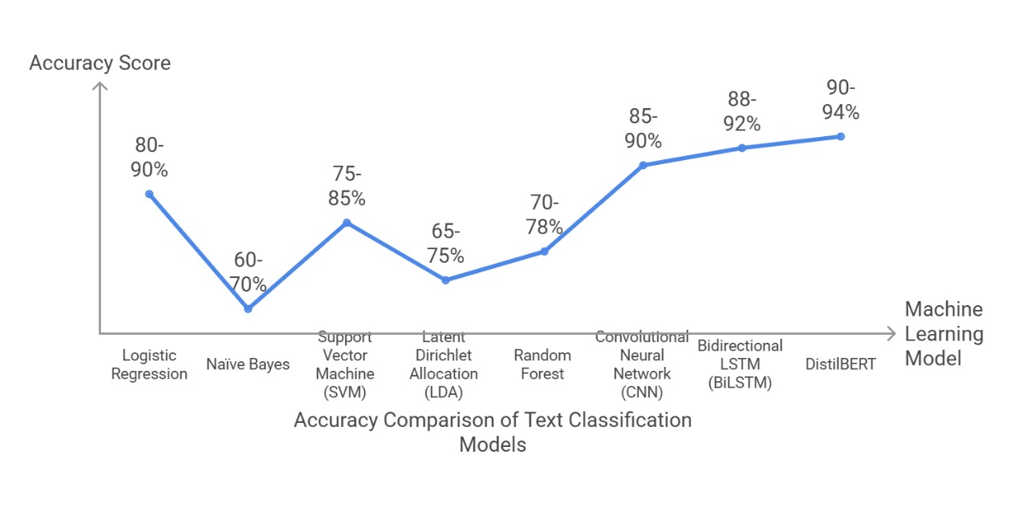
COMPARISON OF DIFFERENT MODELS
12

Slide 13
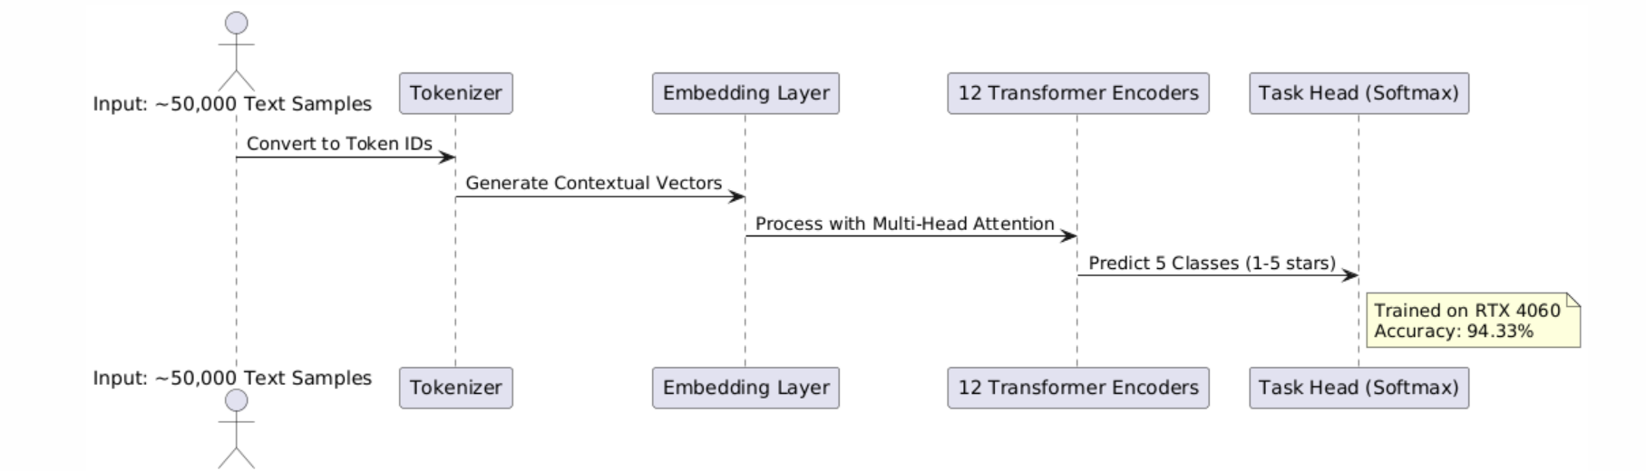
ARCHITECTURE OF BERT
15

Slide 14

METHODOLOGY(BERT)
Data Prep: Tokenize ~50,000 samples, max length 128, create input IDs
Model Setup: bert-base-uncased, 12 Transformer layers, 5-class output
Training: 7 epochs, 2e-5 learning rate, batch size 8, RTX 4060
Validation: 20% split, monitor eval loss to prevent overfitting
Evaluation: Accuracy 94.33%, F1 0.9451, MAE 0.0672
Techniques: Dropout 0.1, early stopping callback
Outcome: Predict nuanced sentiments (e.g., “well” → 5 stars)
20

Slide 15
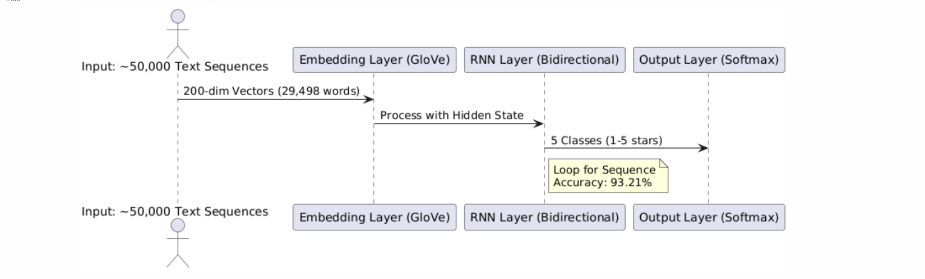
ARCHITECTURE OF RNN
15

Slide 16

METHODOLOGY(RNN)
Data Prep: Embed ~50,000 samples with GloVe (200-dim, 29,498 words)
Model Setup: Bidirectional RNN, 256 hidden units, 5-class softmax
Training: 5 epochs, focal loss, batch size 16, early stopping
Validation: 20% split, check accuracy dip (91.96% peak)
Evaluation: Accuracy 93.21%, F1 0.9345, MAE 0.0820
Techniques: Dropout 0.2 to mitigate overfitting
Outcome: Model sequence-based sentiments effectively
18

Slide 17
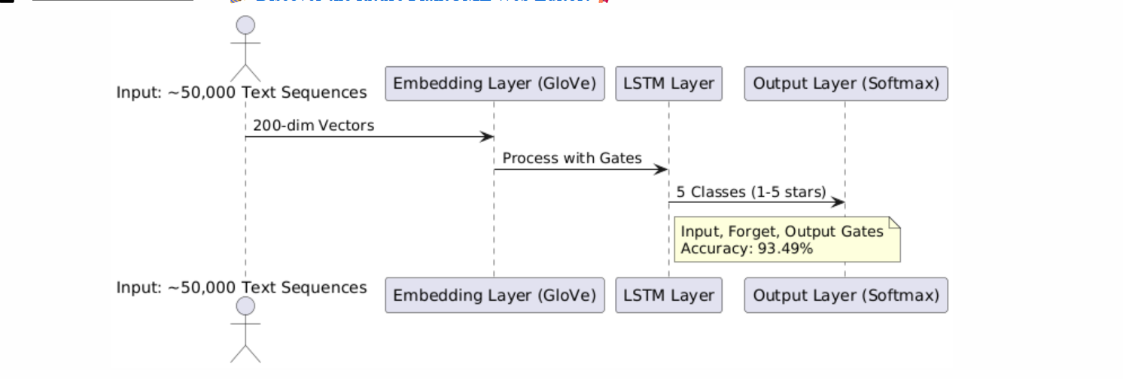
ARCHITECTURE OF LSTM
15

Slide 18
METHODOLOGY(LSTM)
Data Prep: Apply GloVe embeddings (200-dim) to ~50,000 samples
Model Setup: LSTM, 128 hidden units, input/forget gates, 5 classes
Training: 5 epochs, batch size 16, optimize with Adam
Validation: 20% split, ensure stable accuracy (94.52%)
Evaluation: Accuracy 93.49%, F1 0.9370, MAE 0.0772
Techniques: Bidirectional layers, gradient clipping
Outcome: Capture long-term sentiment dependencies
18

Slide 19
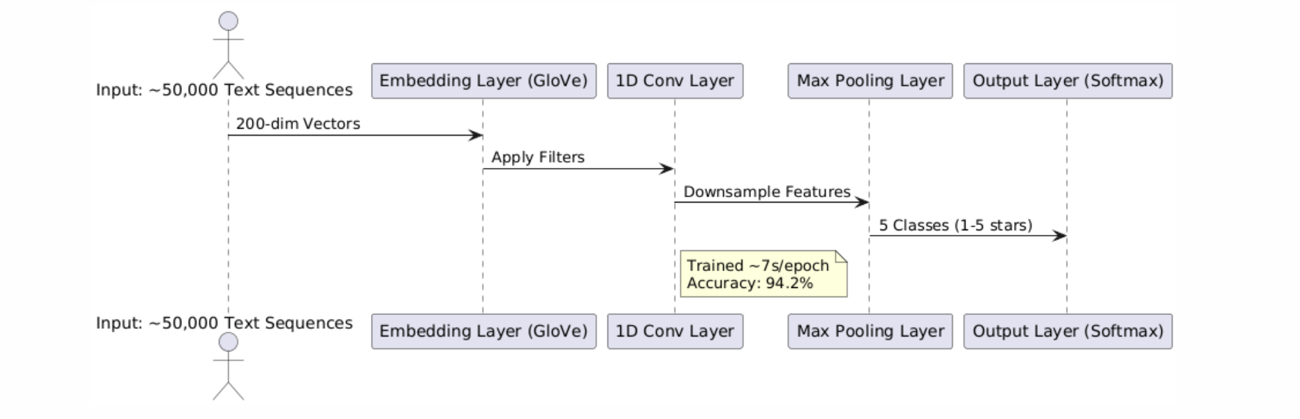
ARCHITECTURE OF CNN
15

Slide 20

METHODOLOGY(CNN)
Data Prep: Embed ~50,000 samples with GloVe (200-dim)
Model Setup: 1D CNN, 64 filters, max pooling, 5-class softmax
Training: 5 epochs, ~7s/epoch, batch size 32, GPU
Validation: 20% split, confirm plateau at 94.66%
Evaluation: Accuracy 94.2%, F1 0.944, MAE 0.0683
Techniques: L2 regularization for robustness
Outcome: Extract local sentiment patterns efficiently
18

Slide 21
RESULT(COMPARISON TABLE)
MODEL | ACCURACY | F1 SCORE | MAE
BERT | 94.33 | 0.9451 | 0.0672
LSTM | 93.49 | 0.9370 | 0.0772
CNN | 94.28 | 0.9446 | 0.0683
RNN | 93.21 | 0.9345 | 0.0820
30

Slide 22
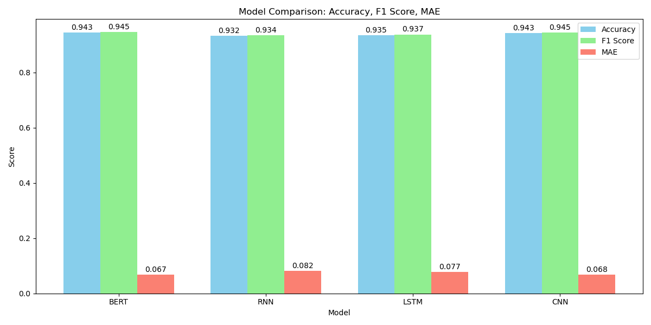
RESULT
The bar chart illustrates the validation performance of each model, with Accuracy (blue) and F1 Score (green) and MAE(red).
MODEL COMPARISON BAR CHART
30

Slide 23
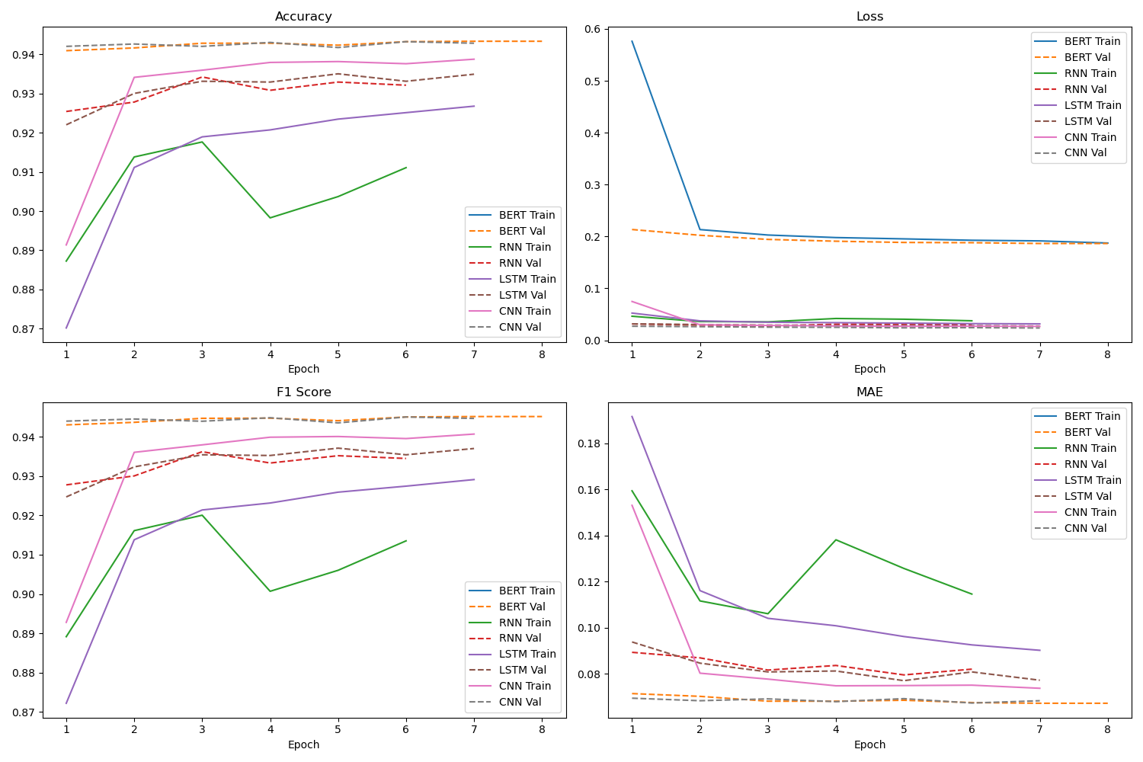
RESULT
This figure presents four subplots depicting the evolution of (a) Accuracy, (b) F1 Score, (c) Loss, and (d) Mean Absolute Error (MAE) for training (solid lines) and validation (dashed lines) datasets.
TRAINING PROGRESS GRAPH
30

Slide 24
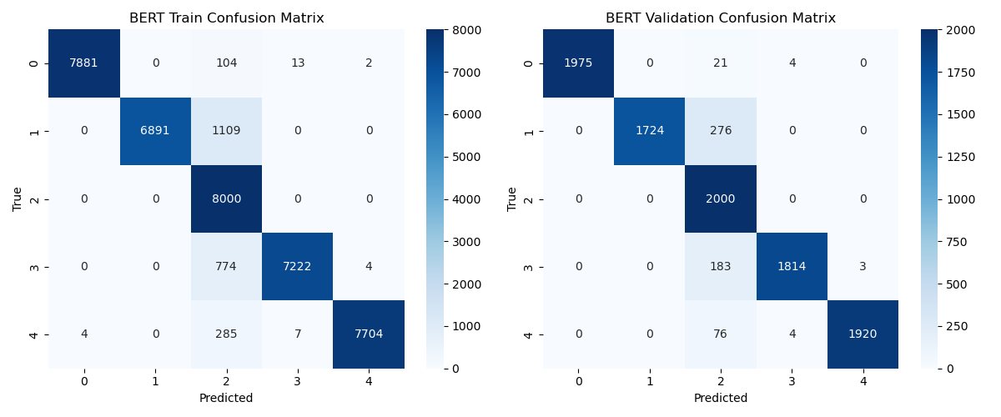
RESULT
Datasets:
Left: Training dataset (10,000 samples)
Right: Validation dataset (2,500 samples)
Axes:
Y-axis: True labels (0-4)
X-axis: Predicted labels (0-4)
Training Matrix Highlights:
High diagonal dominance
Example: 7,881 true negatives predicted as 0
Example: 7,704 true positives predicted as 4
Minimal off-diagonal errors (e.g., 104 misclassified as 1)
Validation Matrix Highlights:
Strong diagonal performance
Example: 1,975 true negatives predicted as 0
Example: 1,920 true positives predicted as 4
Slight increase in misclassifications (e.g., 276 as 1)
Performance Insight: Indicates robust generalization
Overall Accuracy: Approximately 94.3%.
BERT CONFUSION MATRIX
30

Slide 25
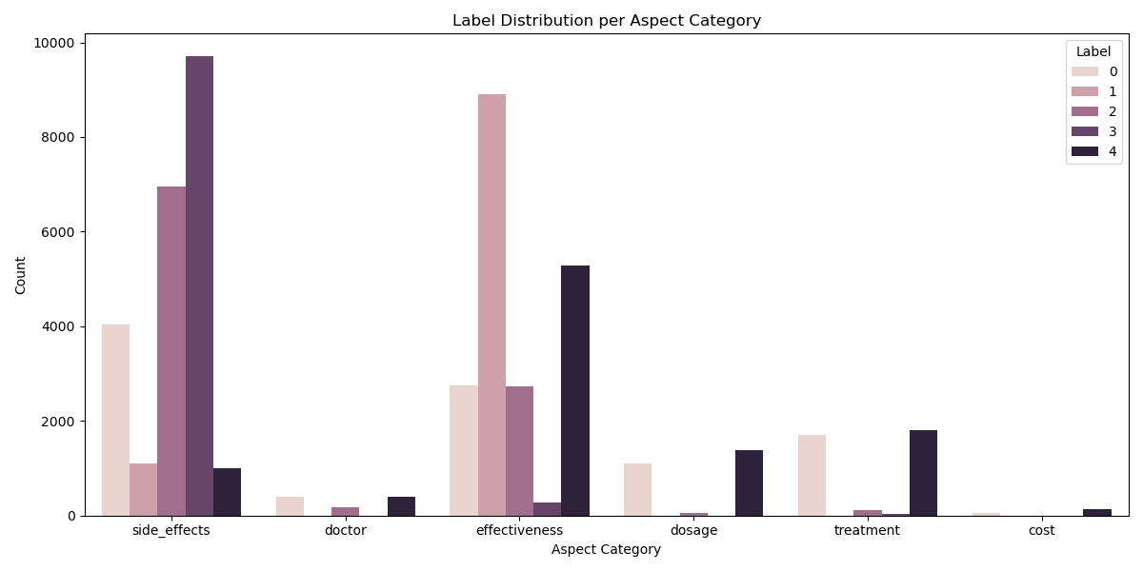
RESULT
Figure Description: Bar chart showing sentiment label (0-4) distribution across six aspects
Aspect Categories: Side effects, Doctor, Effectiveness, Dosage, Treatment, Cost
Labels: 0 (lightest), 1 (light pink), 2 (medium pink), 3 (dark pink), 4 (darkest)
Key Highlights:
  Side Effects: Peaks at Label 4 (~10,000), with Label 0 (~4,000), 1 (~1,500), 2 (~1,000)
  Doctor: Dominated by Label 1 (~9,000), minimal others
  Effectiveness: Highest Label 1 (~9,000), notable 0 (~3,000), 3 (~5,000)
  Dosage: Led by Label 3 (~5,000), lower others
  Treatment: Peak Label 3 (~2,000), moderate 0 (~1,500), 1 (~1,000)
  Cost: Dominated by Label 3 (~2,000), minimal others
Key Insight: Diverse distributions, with side effects and effectiveness varying widely, doctor and cost skewed to specific labels
ASPECT CATEGORY DISTRIBUTION
30

Slide 26
CONCLUSION
Achievement: BERT achieved 94.33% accuracy, outperforming every other model
Insights: Balanced 50,000 samples enabled robust sentiment prediction (e.g., “well” → 5, “bad” → 1)
Scalability: System handles ~161,297 reviews, poised for larger datasets
Diversity: Visualizations reveal varied sentiments, aiding diverse healthcare needs
Application: Supports drug improvement and patient decision-making
30

Slide 27
FUTURE SCOPE
Multilingual Analysis
Support sentiment analysis in major Indian languages for regional inclusivity.
Real-Time Monitoring
Interactive dashboard for live tracking and response to patient reviews.
RAG for Insights
Use Retrieval-Augmented Generation to combine reviews with medical knowledge for contextual analysis and recommendations.
Cross-Platform Analysis
Analyze feedback from social media, forums, and multiple review platforms beyond Google Maps.
Advanced DL Models
Leverage models like RoBERTa, XLNet, and GPT for improved aspect extraction and sentiment accuracy.
31

Slide 28
REFERENCES
1. A. Aman, H. Gupta, M. Kharub, and O. McDermott, “Enablers for Implementing Big data analytics in the Healthcare industry: Prioritization, classification, and implications for sustainable competitive Advantages,” IEEE Transactions on Engineering Management, pp. 1–37, 1 2024. [Online]. Available: https://doi.org/10.1109/tem.2024.3416409
2. N. Pavithra and N. Afza, “Harnessing the power of artificial intelligence and robotics impact on attaining competitive advantage for sustainable development in hospitals with conclusions for future research approaches.” vol. 19, p. Doc15. [Online] 2024. Available: https://pubmed.ncbi.nlm.nih.gov/38655121
3. H. J. Lee, M. Lee, H. Lee, and R. A. Cruz, “Mining service quality feedback from social media: A computational analytics method,” Government Information Quarterly, vol. 38, no. 2, p. 101571, 2021.
4. S. Lenka, V. Parida, and J. Wincent, “Digitalization capabilities as en ablers of value co-creation in servitizing firms,” Psychology Marketing, vol. 34, no. 1, pp. 92–100, 2017.
5. L. Satish and N. Yusof, “A review: big data analytics for enhanced customer experiences with crowdsourcing,” Procedia Computer Science, vol. 116, pp. 274–283, 2017.
6. R. Worlu, O. J. Kehinde, and T. T. Borishade, “Effective customer experience management in healthcare sector of nigeria: a conceptuamodel,” International Journal of Pharmaceutical and Healthcare Marketing, 2016.
7. R. Worlu, O. J. Kehinde, and T. T. Borishade, “Effective customer experience management in healthcare sector of nigeria: a conceptuamodel,” International Journal of Pharmaceutical and Healthcare Marketing, 2016
8. V. K. Omachonu and N. G. Einspruch, “Innovation in healthcare delivery systems: a conceptual framework,” The Innovation Journal: The Public Sector Innovation Journal, vol. 15, no. 1, pp. 1–20, 2010.
9. C. Gentile, N. Spiller, and G. Noci, “How to sustain the customer experience: An overview of experience components that co-create value with the customer,” European Management Journal, vol. 25, no. 5, pp. 395–410, 2007.
10. B. Schmitt, “Experiential marketing,” Journal of Marketing Man agement, vol. 15, no. 1-3, pp. 53–67, 1999, retrieved from https://doi.org/10.1362/026725799784870496.
11. Aditya Raj Sir [JIO PLATFORMS]
32

Slide 29
THANK YOU

